Slide 1
SHARDS: An unbiased spectro-photometric survey of passively evolving galaxies at z>1 in GOODS-N
Pablo G. Pérez-González
Ramón y Cajal Associate Professor at UCM
Associate Astronomer at Steward Observatory
Co-I´s: G. Barro, M. Balcells, N. Cardiel, J. Cenarro, J. Cepa, S. Charlot, A. Cimatti, C. Conselice, E. Daddi, J. Donley, D. Elbaz, I. Ferreras, J. Gallego, R. Gobat, R. Guzmán, A. Renzini, L. Tresse, I. Trujillo, J. Zamorano
Universidad Complutense de Madrid (UCM)
University of Arizona (UofA)

Slide 2
The classical view on galaxy formation
Ellis et al. (2000)

Slide 3
The current paradigm for galaxy formation
Ellis et al. (2000)

Slide 4
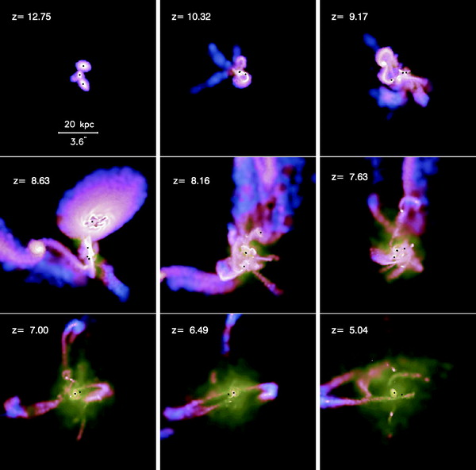
The paradigm for galaxy formation: models
Li et al. (2008)

Slide 5
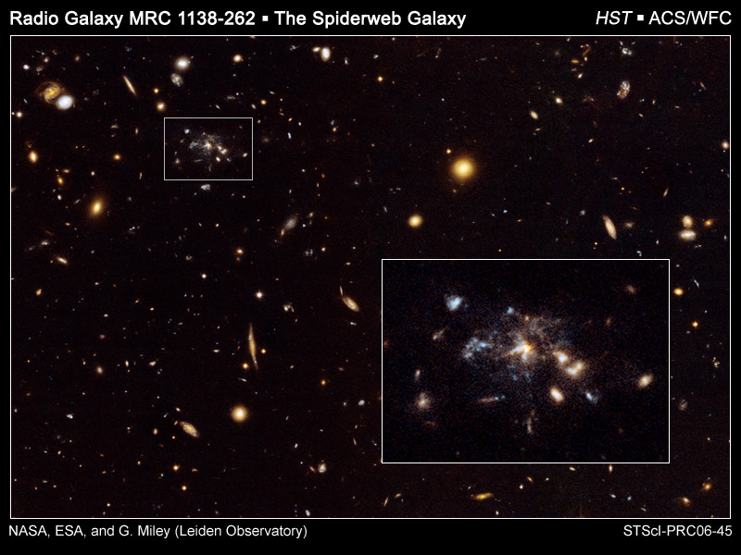
The paradigm for galaxy formation: data
Miley et al. (2006)

Slide 6
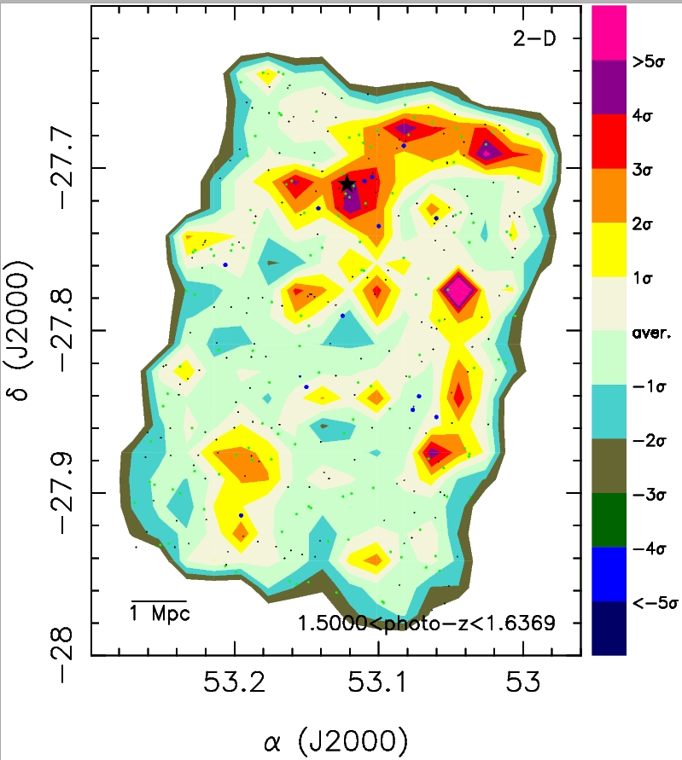
Checking the paradigm: environmental effects
Rainbow Database
Literature comparison:
Castellano et al. (2007) reported a forming cluster at z=1.6 in GOODS-S
Pérez-González et al. (in preparation)
GOODS-S

Slide 7
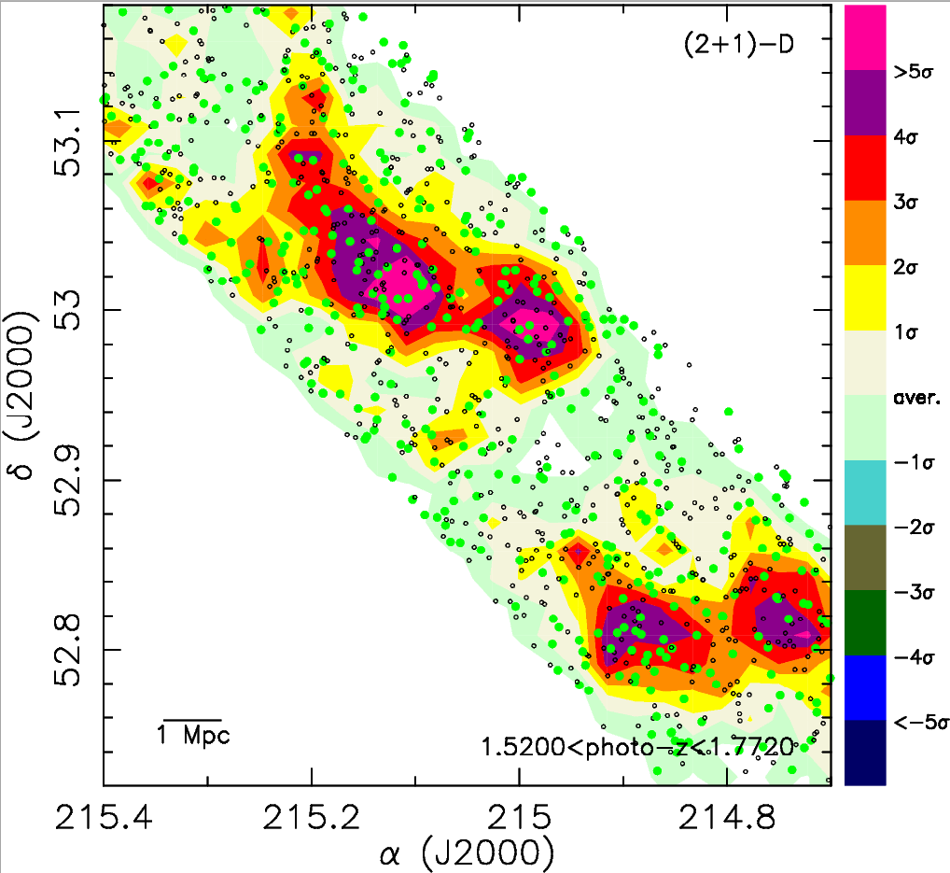
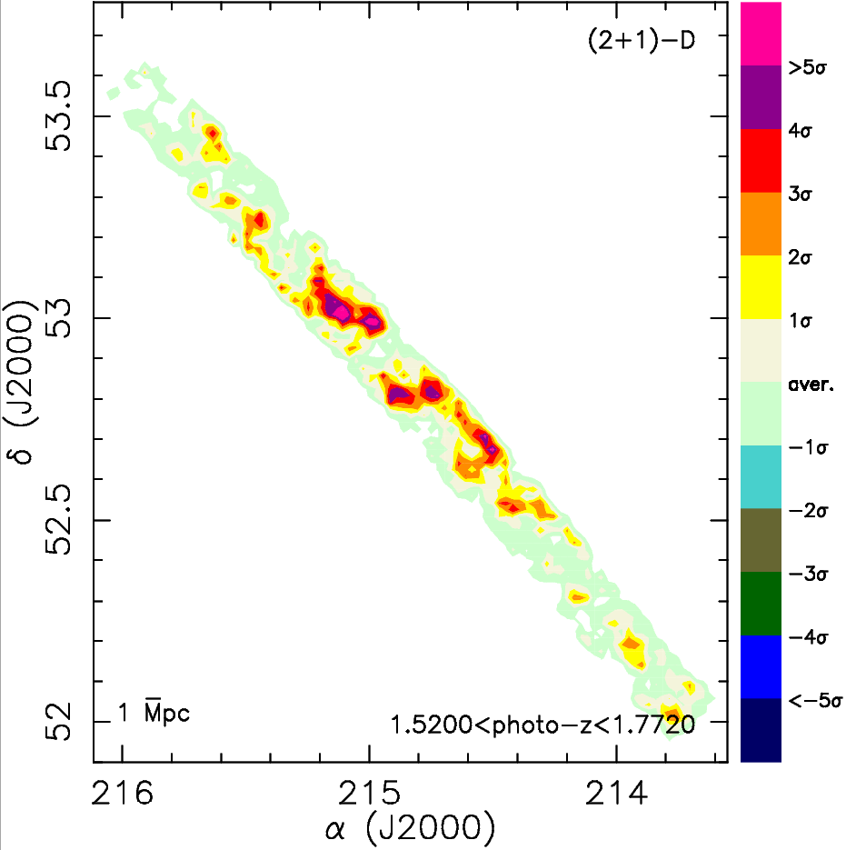
Checking the paradigm: environmental effects
photo-z (R<24)
photo-z (R>24)
Rainbow Database
GTC CAT approved OSIRIS/MOS proposal: 21 hours in 2009B (resubmitted in 2010A) PI: Pérez-González
GOODS-S
EGS

Slide 8
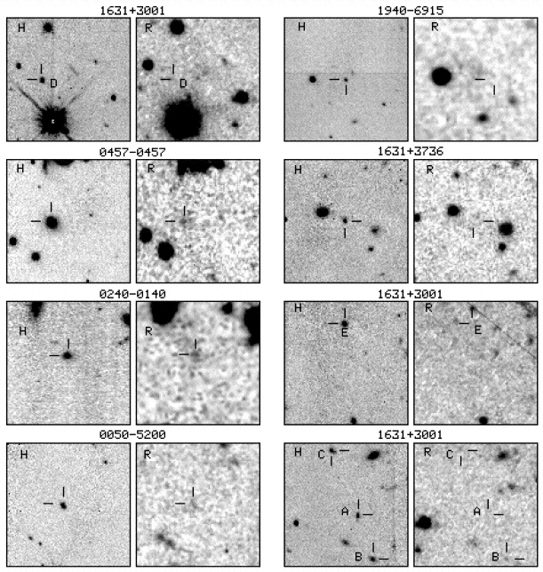
Checking the paradigm: many massive galaxies at z>1!
Yan et al. (2000)
Franx et al. (2003)
Daddi et al. (2004)

Slide 9
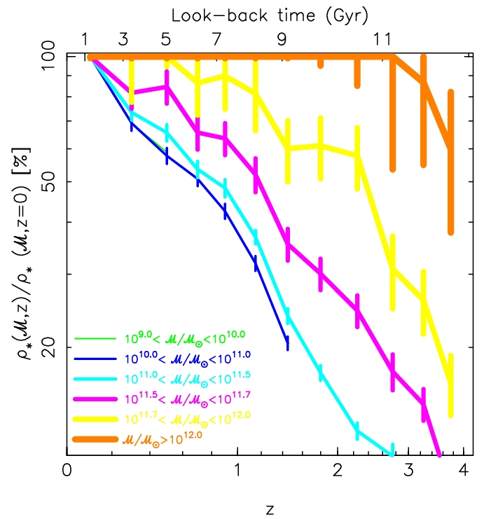
Checking the paradigm: many massive galaxies at z>1!
Pérez-González et al. (2008a)
Notes:
Possibility of showing SFRs calculated with 24 micron.

Slide 10
Checking the paradigm: many massive galaxies at z>1!
Marchesini et al. (2009)
Notes:
Possibility of showing SFRs calculated with 24 micron.

Slide 11
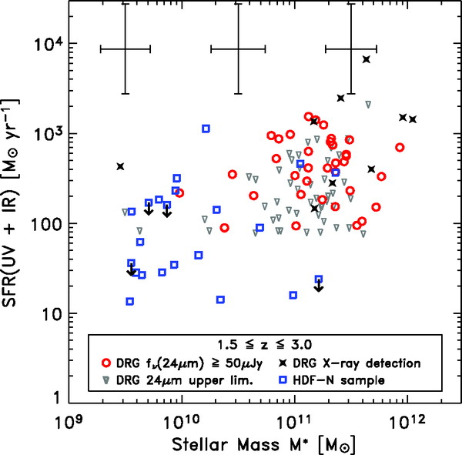
Half of them are already quiescent
Papovich et al. (2006)
Notes:
Possibility of showing SFRs calculated with 24 micron.

Slide 12
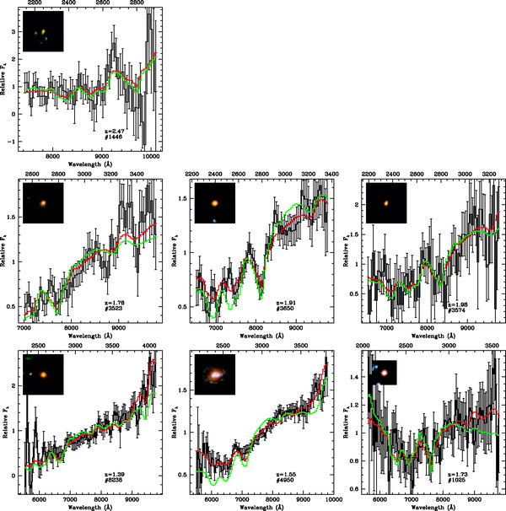
And they are very compact!!!
Daddi et al. (2005) Trujillo et al. (2007)

Slide 13
Characterizing red and dead galaxies
13 objects in 480 hours with VLT!!!
Cimatti et al. (2008)

Slide 14
The Mg(UV) spectral index as an age indicator
Daddi et al. (2005)

Slide 15
SHARDS: Survey for High-z Absorption Red and Dead Sources
http://guaix.fis.ucm.es/~pgperez/SHARDS

Slide 16
SHARDS: Survey for High-z Absorption Red and Dead Sources
Proposed as an ESO/GTC Large Program in March 2009 (PI: Pérez-González, 19 co-I’s).
20 nights awarded in 2010A and 2011A.
2 OSIRIS pointings in GOODS-N with 25 filters each.
GTC/Consolider Project approved grant to buy dedicated set of 25 medium-band (FWHM=17 nm) filters.

Slide 17
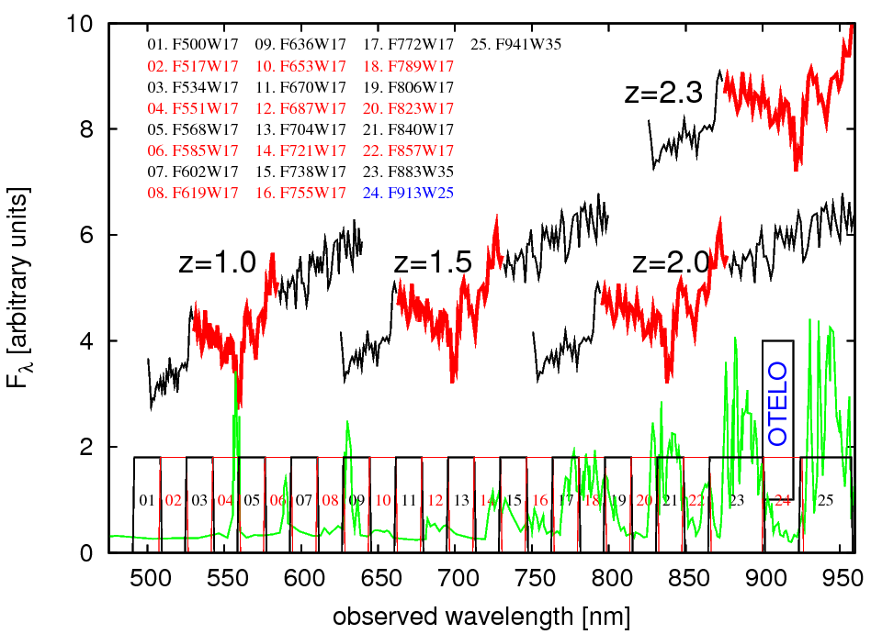
SHARDS: instrumental setup

Slide 18
SHARDS: observational facts
25 filters from 500 to 950 nm:
22 with FWHM=17 nm
3 reddest filters with FWHM=25-35 nm.
Blue filters (λ<660 nm) to reach 27.0^{mag} at 3σ.
Red filters (λ>660 nm) to reach 26.5^{mag} at 3σ.
Exposure times will range from 4 to 30 ks.
2 OSIRIS pointings x25 filters to cover GOODS-N.
Detailed calibration needed, including imaging & spectroscopic observations: effect of sky variability, spatial variation of passband,…

Slide 19
SHARDS: Mg(UV) index with photometry

Slide 20
SHARDS: better photo-z’s
Ilbert et al. (2009)
12 filters @ 25^{mag} (20-30 nm width) Δz/(1+z)<0.01!!!

Slide 21
SHARDS: detecting ELGs
Ellis et al. (2000)

Slide 22
SHARDS: Summary
Main science case:
Detection of z>1 ETGs, ages with Mg(UV).
Examples of other science cases:
Balmer breaks and D(4000) for z<1 sources.
Accurate photo-z’s for all sources in field.
Stellar population modeling with 25 filters.
ELGs: star-forming and AGN.
Program to start in March 2010
Extension to other fields (such as EGS) with other telescopes (such as Subaru)?

Slide 23
http://guaix.fis.ucm.es/~pgperez/SHARDS

Slide 25
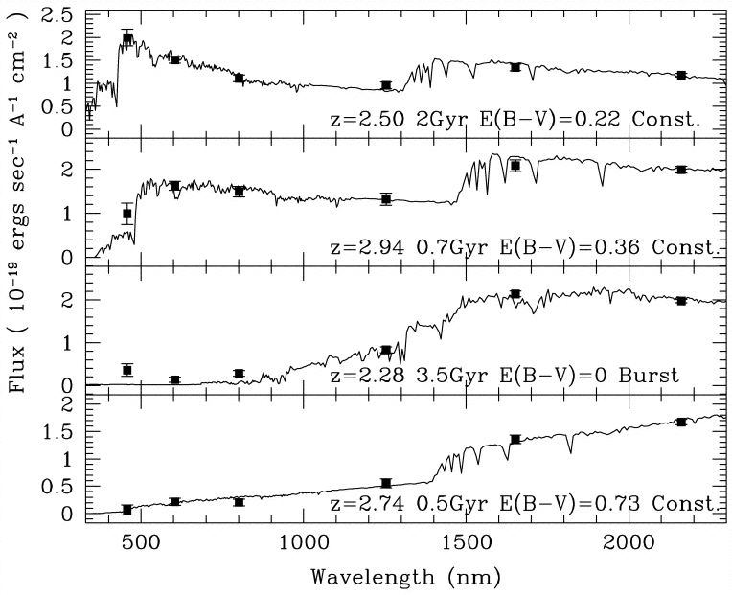
Checking the paradigm: many massive galaxies at z>1!
Franx et al. (2003)

Slide 26
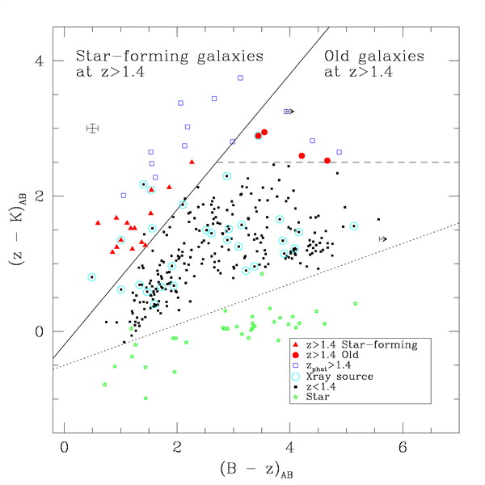
Checking the paradigm: many massive galaxies at z>1!
Daddi et al. (2004)

Slide 27
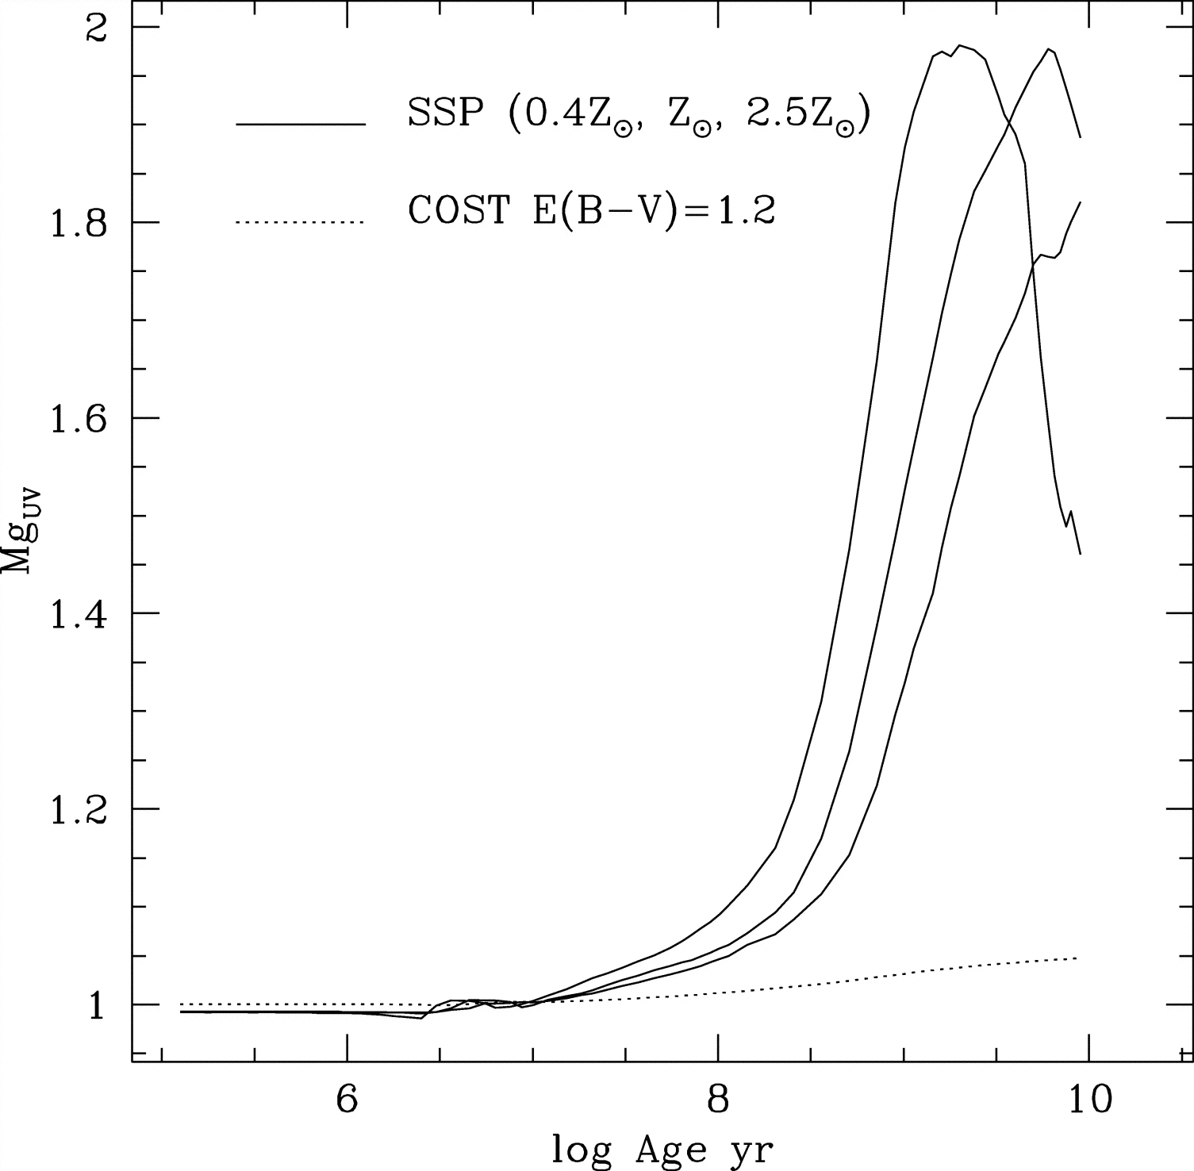
The Mg(UV) spectral index as an age indicator
Daddi et al. (2005)

Slide 28
And they are very compact!!!
Trujillo et al. (2007)

Slide 29
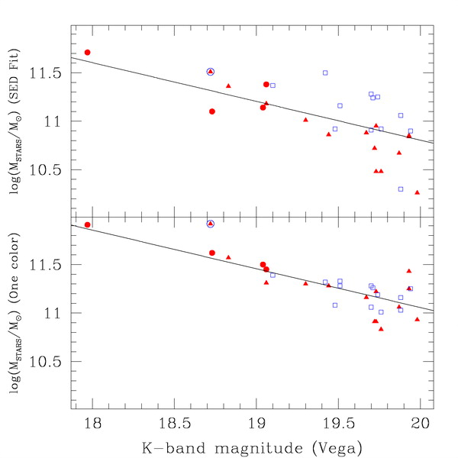
Checking the paradigm: many massive galaxies at z>1!
Daddi et al. (2004)

Slide 30
Characterizing red and dead galaxies
Cimatti et al. (2008)

Slide 31
Characterizing red and dead galaxies
Cimatti et al. (2004)
Cimatti et al. (2008)
McCarthy et al. (2004)

Slide 32
SHARDS: Mg(UV) index with photometry

Slide 33
SHARDS: Mg(UV) index with photometry

Slide 34
SHARDS: Mg(UV) index with photometry

